Slide 1
3D Image Segmentation and Quantification of Lysosomes
21/1/2025

Slide 2
GUI

Slide 3
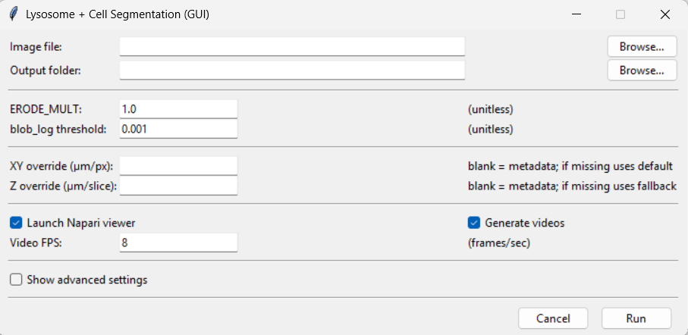
GUI WITHOUT ADVANCED SETTINGS
1
2
3
4
5
6
7
8
9
10

Slide 4
Inputs and buttons
1) Image file
Text box
Shows the full path of the file you selected (.czi, .tif, .tiff).
Browse… (button)
Opens a file picker. When you choose a file, the GUI also auto-suggests an output folder (same directory as the image + timestamp) if the output field is empty.
2) Output folder
Text box
Where all outputs are written:datasets, videos and pictures
Browse… (button)
Lets you choose a parent folder.
The script then makes a new timestamped folder inside it (based on the image name).
3) ERODE_MULT
ERODE_MULT (input): A multiplier / additive factor used in your auto morphology stage.
Units: unitless (it becomes a voxel radius for erosion).
Effect: higher values generally shrink the mask more (more erosion).
For neurites: too high will break thin branches.
Typical:
Image with little noise: 0-2
Image with a lot of noise: >=3

Slide 5
Inputs and buttons
4) Blob_log threshold
Input:
Controls how strict the lysosome detection is using the function blog_log.It’s basically the minimum “blob response” required to call something a blob.
Units: unitless.
Effect:
Lower threshold → more detections (including noise)
Higher threshold → fewer detections (may miss lysosomes)
Typical: 0.001–0.05, depends on intensity / noise.
5) XY override (µm/px)
Input
If you leave it blank: the script tries metadata (vx_um, vy_um)
if missing → uses the default you set (e.g. 0.04 µm/px)
If you fill it: it forces vx_um = vy_um = your_value
Units: micrometers per pixel (µm/px)
Affects: any calculation converting pixels → µm, including: lysosome size in µm, distance maps in µm, MARGIN_UM behavior (because it’s in µm) and voxel volume in µm³.

Slide 6
Inputs and buttons
6) Z override (µm/slice)
Input
If blank: uses vz_um from metadata
if missing:uses DEFAULT_VZ_UM if provided
If filled:forces vz_um = your_value
Units: micrometers per Z step (µm/slice)
Affects: 3D distances and volumes, distance transform sampling in µm, overlap sphere geometry in µm and volume per voxel.
7) Launch Napari viewer (checkbox)
If checked: opens napari, adds layers.
If unchecked: the script runs headless (still saves outputs).
Affects: only visualization (not segmentation output itself).
8) Generate videos (checkbox)
If checked: writes MP4/GIF outputs(fused overlays, side-by-side raw vs fused)
If unchecked: no videos are generated.
Affects: only outputs (not segmentation).
9) Video FPS
INPUT: Frames per second for the MP4/GIF writers.
Units: frames/second
Affects: playback speed only.

Slide 7
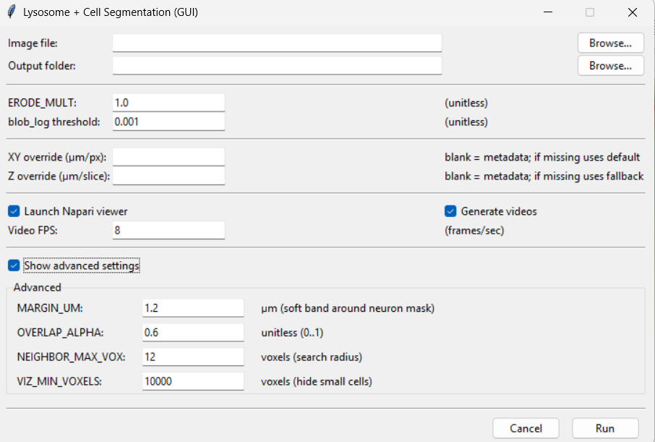
GUI WITH ADVANCED SETTINGS
10
11
12
13
14
15
16

Slide 8
Inputs and buttons
10) Show advanced settings (checkbox)
Toggles visibility of the advanced panel.
11) MARGIN_UM (µm)
Soft distance band around the neurite mask; helps classify lysosomes near the border as “inside”.
Units: micrometers (µm)
12) OVERLAP_ALPHA (0….1)
Minimum fraction of the lysosome sphere that must overlap the neurite mask to be “inside”.
Units: unitless fraction
13) NEIGHBOR_MAX_VOX (voxels)
How far (in voxels) to search for the nearest nonzero label when assigning an ID.
Units: voxels
14) VIZ_MIN_VOXELS (voxels)
Minimum component size (voxel count) to keep for visualization/IDs; smaller ones are removed.
Units: voxels
Bottom buttons
15)Cancel:Closes the GUI and exits the scrip.
16)Run:Validates inputs and run the script.

Slide 9
AXONS

Slide 10
FILES:
-Airy scan_40A_UAS-TMEM-HA_axon_0h_again_2_051222
-Airy scan_40A_UAS-TMEM-HA_axon_0h_again_3_051222
-Airy scan_40A_UAS-TMEM-HA_axons_4h_1_291122
-Airy scan_40A_UAS-TMEM-HA_axons_L3_x63_1_180123

Slide 11
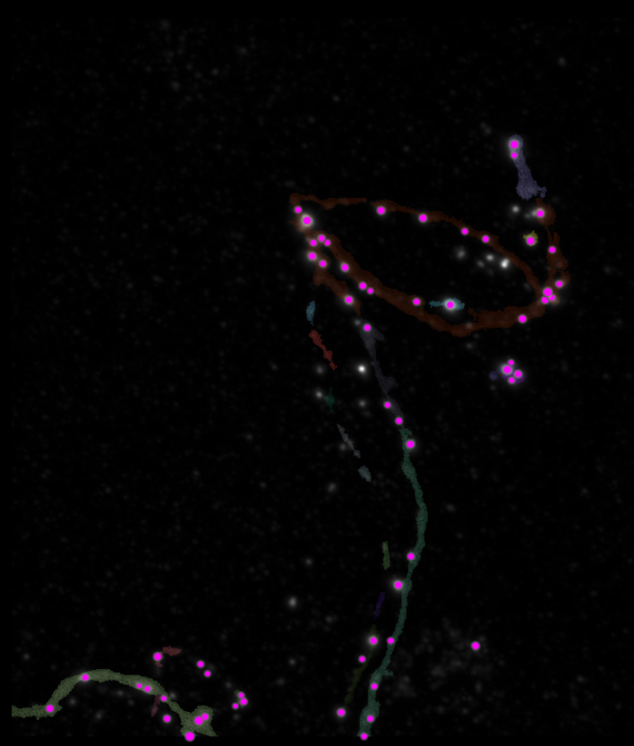
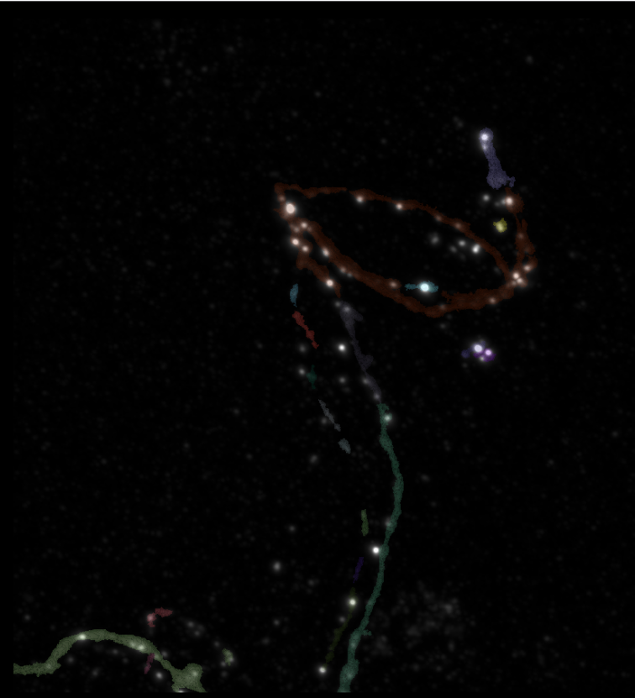
0H 2
Erosion = 0
Thresholding = 0.001
margin um = 0.5
overlap alpha = 0.4
neigh max vox = 6
viz min voxels = 1000

Slide 12
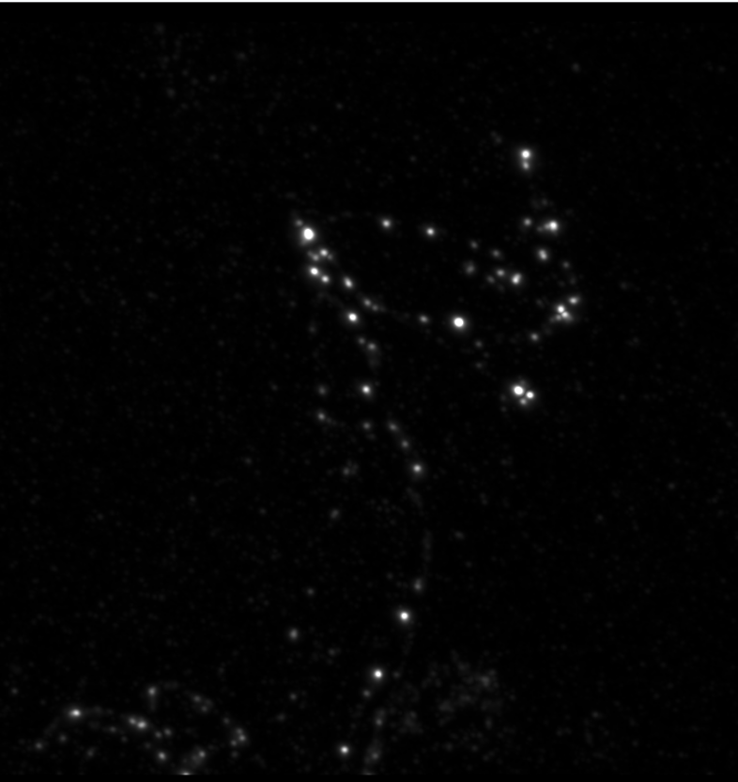
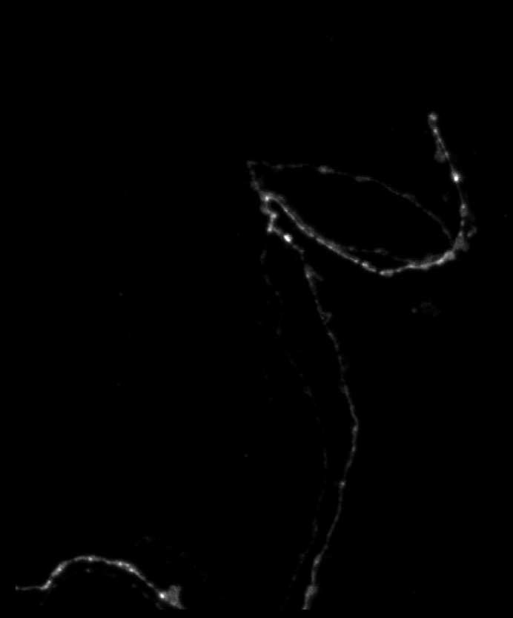
0H 2

Slide 13
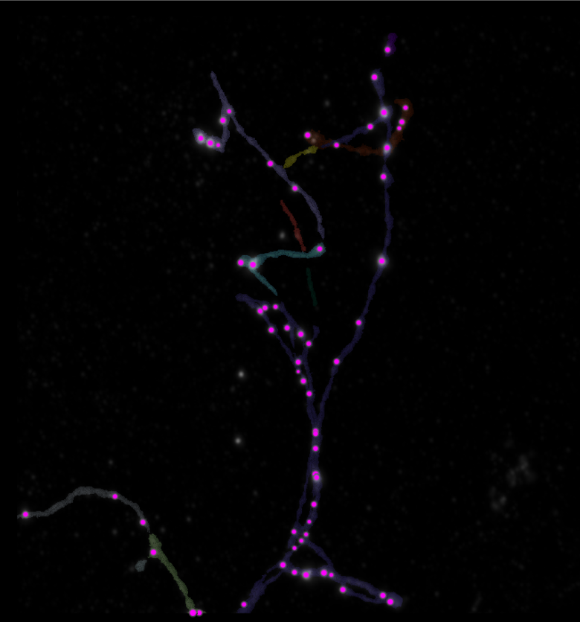
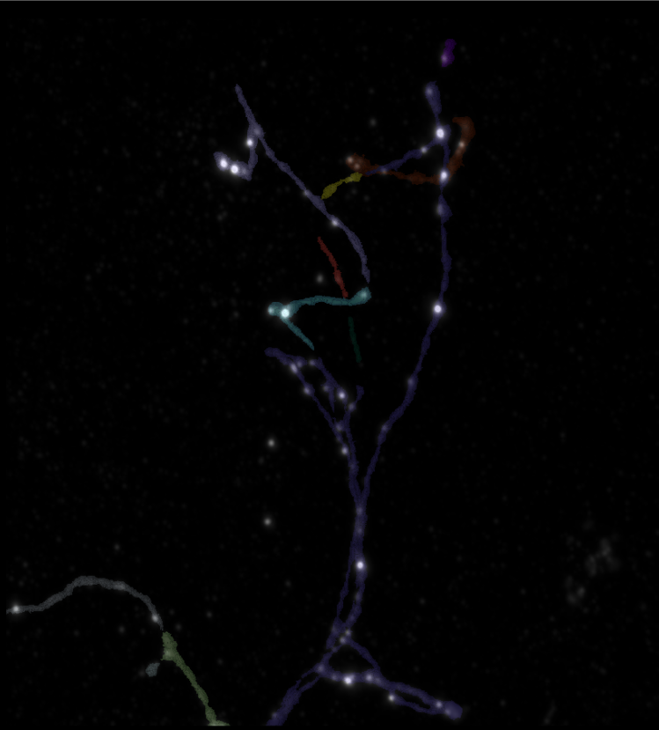
0H 3
Erosion = 0
Thresholding = 0.001
margin um = 0.5
overlap alpha = 0.4
neigh max vox = 6
viz min voxels = 2000

Slide 14
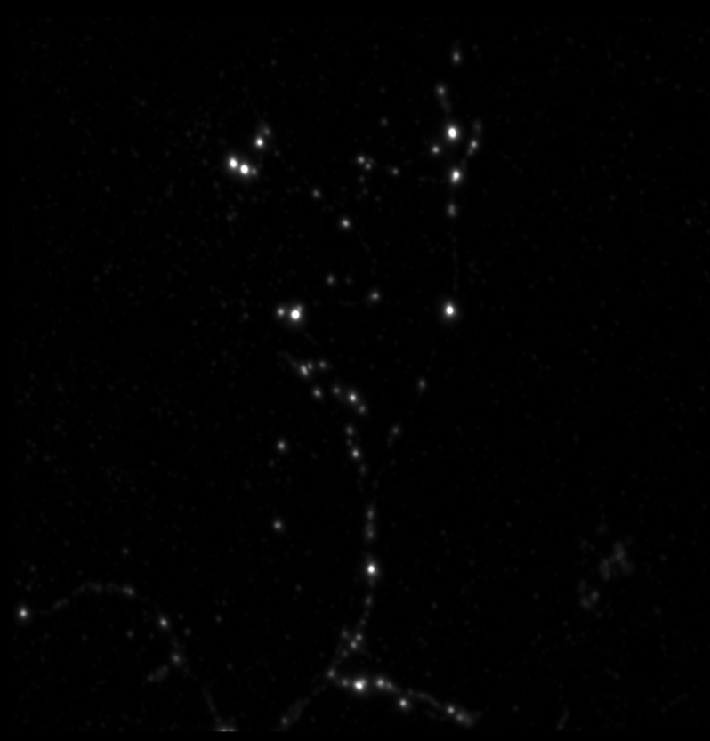
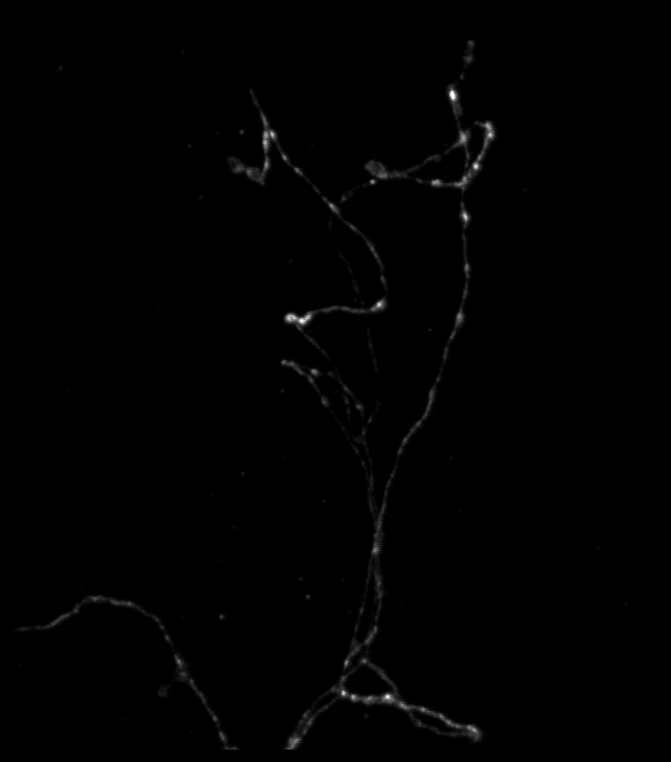
0H 3

Slide 15
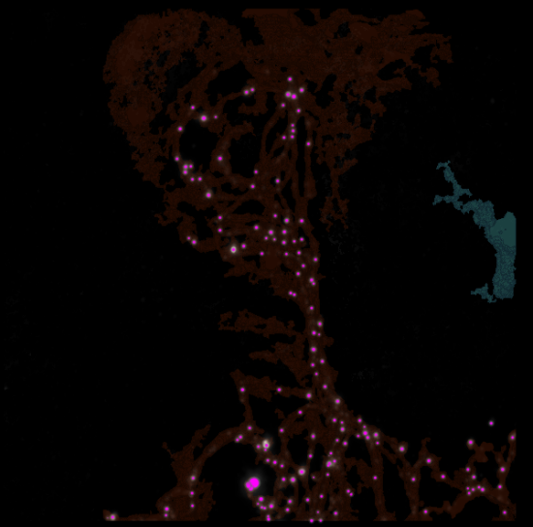
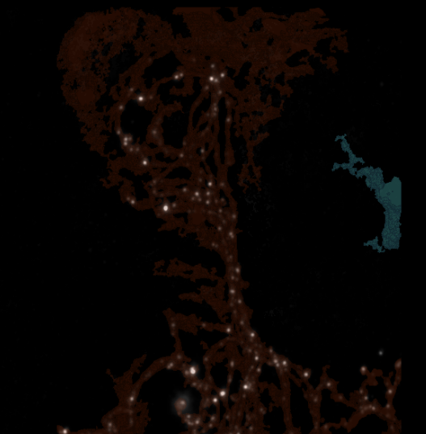
4H 1
Erosion = 30
Thresholding = 0.001
margin um = 0.5
overlap alpha = 0.4
neigh max vox = 6
viz min voxels = 100000

Slide 16
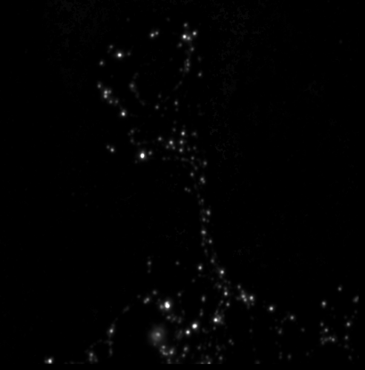
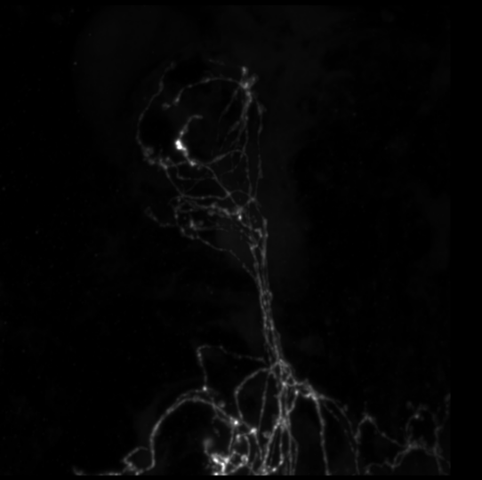
4H 1

Slide 17
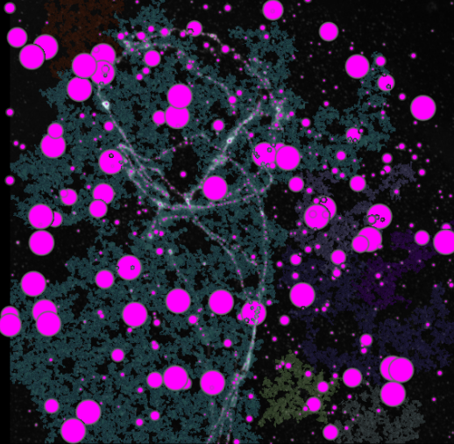
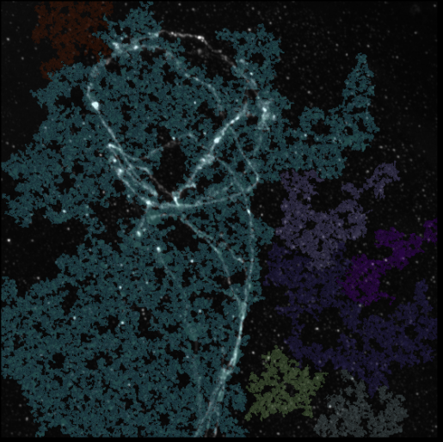
L3 1
Erosion = 40
Thresholding = 0.01
margin um = 0.5
overlap alpha = 0.4
neigh max vox = 6
viz min voxels = 100000

Slide 18
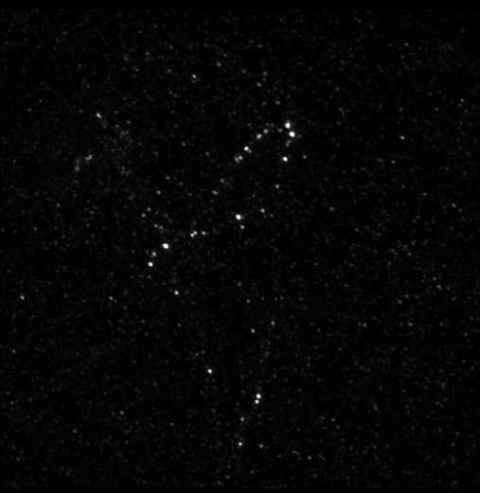
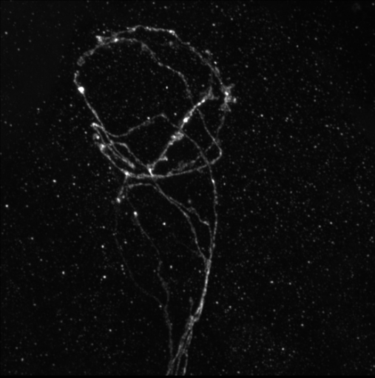
L3 1

